Slide 1


A conceptual IoT framework based on ANOVA-F Feature Selection for Chronic kidney Disease detection using Deep Learning Approach
Md. Morshed Ali
ID: B170305013
Department of Computer Science & Engineering
Jagannath University
Morshedali.cse.jnu@gmail.com
Supervised By
Presented By
Dr. Mohammed Nasir Uddin
Professor
Department of Computer Science &
Engineering
Jagannath University
Nasir.jnu.cse@gmail.com

Slide 2









Presentation Agenda
Introduction
Motivation
Problem Statement
Objective
Contribution
Existing Works
Proposed Methodology
Evaluations and results
Conclusion

Slide 3
Introduction
Chronic kidney disease (CKD)
Renal failure
Blood pressure
Hypertension
Diabetes
Anemia
Nerve Damage
With no cure and high morbidity, CKD is common in the adult population
Defined by the reduction of kidney function

Slide 4

Introduction
Affects over 100 million Europeans
World’s fifth-greatest cause of death – 2040
Psychiatric difficulties - more than 50% of ESKD with hemodialysis patients
Over 350 illnesses are recorded by GBDR
CKD is one of them

Slide 5
Presentation Agenda
Introduction
Motivation
Problem Statement
Objective
Contribution
Existing Works
Proposed Methodology
Evaluations and results
Conclusion

Slide 6

Motivation
In CKD, Kidney transplant is life saving but expensive treatment for general people.
Clinically diagnosis of the risk factors are mostly manual and time consuming.
IoT schema is popular for low-cost sensors, to monitor health remotely

Slide 7
Presentation Agenda
Introduction
Motivation
Problem Statement
Objective
Contribution
Existing Works
Proposed Methodology
Evaluations and results
Conclusion

Slide 8
Problem Statement
Detection of Kidney Disease requires:
Primary biomarkers to test ( Costly test, Availability of sample )
Diagnosis system is manual or done by Specializer (Slow process)
Apart from these:
Lack of proper medical information
Data danger and Avoidable mistakes
Misinterpretation, and delayed transmissions
Existing applications for CKD are still in their infancy
What would be the solution for these problem ?

Slide 9
Problem Statement
Solution
1. Cheaper way to collect data
2. An automatic diagnosis system

Slide 10
Presentation Agenda
Introduction
Motivation
Problem Statement
Objective
Contribution
Existing Works
Proposed Methodology
Evaluations and results
Conclusion

Slide 11

Objective
To reduce mistakes and misinterpretation,
For Collecting data, a conceptual sensor layer works includes IoT devices.
To detects CKD accurately,
Proposed a premium classifier, MLP, based on the Anova-F feature selection technique.

Slide 12
Presentation Agenda
Introduction
Motivation
Problem Statement
Objective
Contribution
Existing Works
Proposed Methodology
Evaluations and results
Conclusion

Slide 13

Contribution
A Conceptual IoT framework,
Data could be collected using IoT sensors.
To dataset for high accuracy,
Choose a feature selection technique with based on score and comparison
Statistical analysis by comparing
accuracy, f1-score, precision, recall, and computational time
Disease detection using Deep Learning

Slide 14


Background Study
Internet of Things (IoT)
Microcomputers, can connect to a network and transport data electro.
IoT devices are used for
remote healthcare monitoring
real-time device tracking
treat patients
operate remotely
quickly acquire patient information

Slide 15
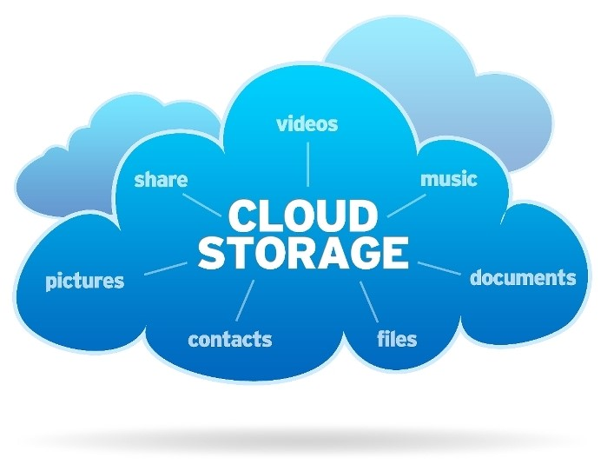
Background Study
Cloud Storage Service
Type of cloud computing concept.
This service allows clients
To store data in the cloud
Provides data security, monitoring, and maintenance
Infinite scalability, and flexible capacity
Data access ability from anywhere

Slide 16
Presentation Agenda
Introduction
Motivation
Problem Statement
Objective
Contribution
Existing Works
Proposed Methodology
Evaluations and results
Conclusion

Slide 17
Existing Works
Author & Year | Contribution | Plat-form | Dataset | Feature Selection | Accuracy | Limitations
Abdelaziz,Ahmed, et al (2019) [27] | Hybrid intelligent model based on cloud-IOT by using LR and NN | Cloud | UCI Repository Dataset (400) | no | 97.8% | Need to analyze big data. Scope of Improving accuracy using different model
Hosseinzadeh, Mehdi, et al. (2021) [19] | A diagnostic prediction model using Machine Learning approach | IoT | simulated IoT data (300) | no | 97% | Model is not applied in real IoT environment Less number of instances
[27] A. Abdelaziz, A. S. Salama, A. Riad, and A. N. Mahmoud, “A machine learning model for predicting of chronic kidney disease based internet of things and cloud computing in smart cities,” in Security in smart cities: models, applications, and challenges. Springer, 2019, pp. 93–114.
[19] M. Hosseinzadeh, J. Koohpayehzadeh, A. O. Bali, P. Asghari, A. Souri, A. Mazaherinezhad, M. Bohlouli, and R. Rawassizadeh, “A diagnostic prediction model for chronic kidney disease in internet of things platform,” Multimedia Tools and Applications, vol. 80, no. 11, pp. 16 933–16 950, 2021.

Slide 18
Existing Works
Author & Year | Contribution | Plat-form | Dataset | Feature Selection | Accuracy | Limitations
Suliman Alsuhibany, Suliman A., et al. (2021) [23] | Ensemble of Deep Learning Based Clinical Decision Support System using CNN-GRU | IoT | UCI Repository Dataset (400) | Chi squared | 96.2% | Accuracy could be increase
Mohammad Ayoub Khan (2020) [30] | IoT Framework based on Modified Deep Convolutional Neural Network (MDCNN) | IoT | UCI dataset(303) | Mapping based | 98.2% | -
[23] S. A. Alsuhibany, S. Abdel-Khalek, A. Algarni, A. Fayomi, D. Gupta, V. Kumar, and R. F. Mansour, “Ensemble of deep learning based clinical decision support system for chronic kidney disease diagnosis in medical internet of things environment,” Computational Intelligence and Neuroscience, vol. 2021, 2021.
[30] M. A. Khan, “An iot framework for heart disease prediction based on mdcnn classifier,” IEEE Access, vol. 8, pp. 34 717–34 727, 2020

Slide 19
Existing Works
Author & Year | Contribution | Plat-form | Dataset | Feature Selection | Accuracy | Limitations
Poonia, Ramesh Chandra, et al. (2022) [29] | Intelligent diagnostic prediction using KNN, ANN, SVM | - | UCI Repository Dataset (400) | Chi squared | 98.75% | -
Arulanthu, Pramila et al. (2020) [18] | Online medical decision support system (OMDSS) | IoT | UCI Repository Dataset (400) | No | 97.75% | No clustering technique No use of feature selection
[29] R. C. Poonia, M. K. Gupta, I. Abunadi, A. A. Albraikan, F. N. Al-Wesabi, and M. A. Hamza, “Intelligent diagnostic prediction and classification models for detection of kidney disease,” in Healthcare, vol. 10, no. 2. MDPI, 2022, p. 371.
[18] P. Arulanthu and E. Perumal, “An intelligent iot with cloud centric medical decision support system for chronic kidney disease prediction,” International Journal of Imaging Systems and Technology, vol. 30, no. 3, pp. 815–827, 2020.

Slide 20
Presentation Agenda
Introduction
Motivation
Problem Statement
Objective
Contribution
Existing Works
Proposed Methodology
Evaluations and results
Conclusion

Slide 21
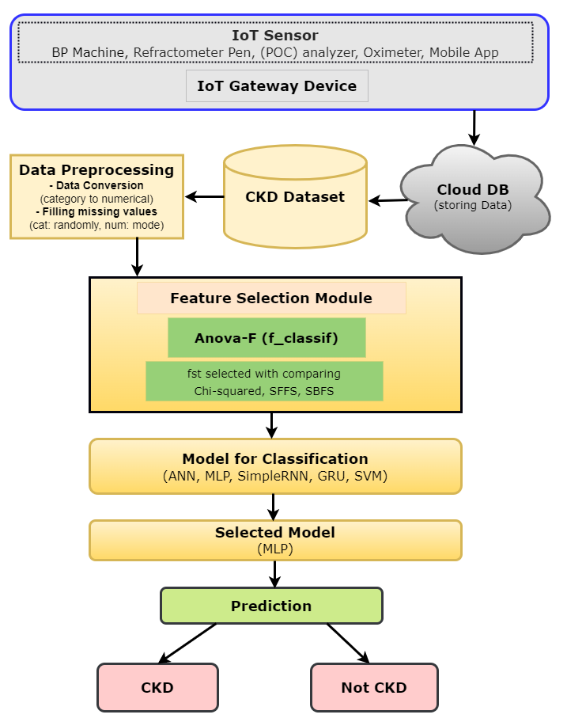
Proposed System

Slide 22


Data Collection
In our conceptual model
Data are collected through IoT Sensor layer
IoT Sensor Layer
Sensor layer includes
BP Machine: blood pressure
Refractometer PEN: Urine Specific Gravity
(POC) Analyzer: Albumin, White blood cells count, Red blood cells count, Sodium, Blood glucose random, Potassium, Serum Creatinine, and Hemoglobin
Oximeter: hemoglobin saturation
Mobile Application: Other features

Slide 23
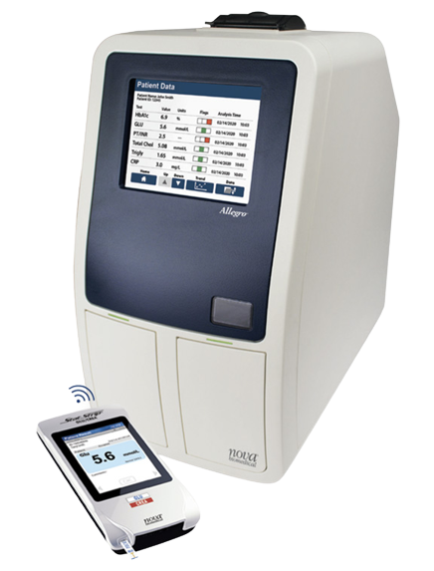
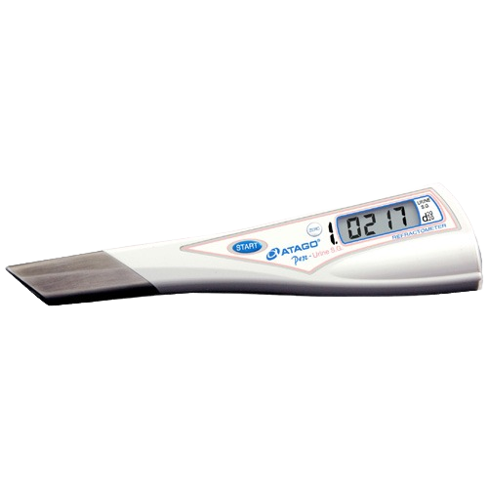
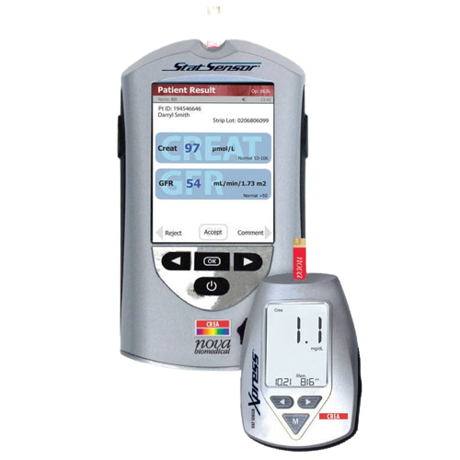
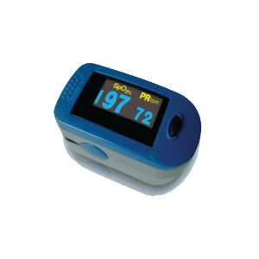
Data Collection
Refractometer PEN
Oximeter
BP Machine
(POC) analyzer

Slide 24
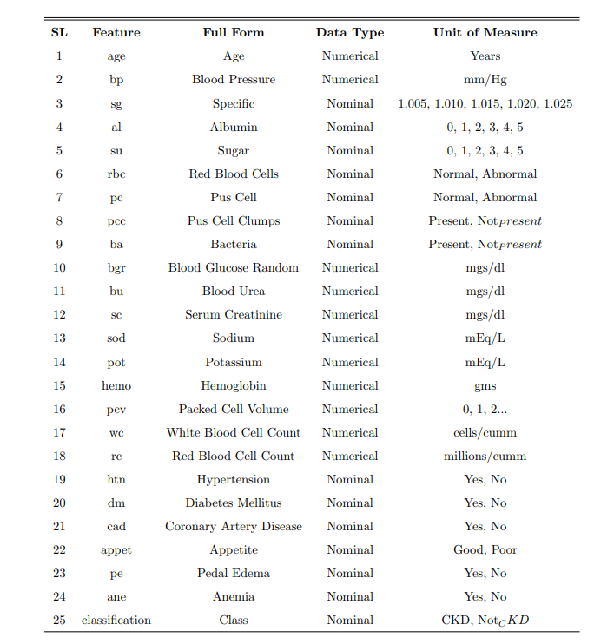
Data Collection
UCI Repository Std CKD dataset
Dataset description:
Number of samples 400,
Number of attributes 25,
250 samples under CKD,
And 150 sample not CKD
Among 15 attributes
11 are numerical and
14 are nominal or categorical

Slide 25
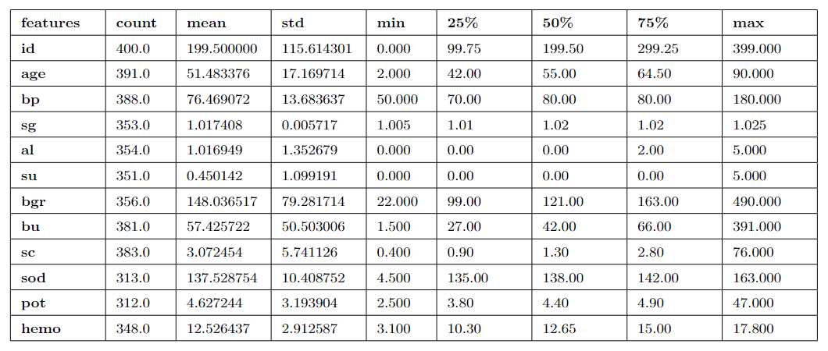

Data Pre-Processing
Filling missing values
After visualizing graphically
By comparing “random value imputation” method
missing values are filled by mode and median strategy
Conversion of categorical value
Label encoding for binary values

Slide 26
Feature Selection
Anova-F: Analysis of Variance -based on the f1 score and using f_classif function
['bp','sg','al','su','pc','bgr','bu','sc','sod','hemo','pcv','rc','htn','dm','appet','pe','ane’]
Chi-squared: variance between the nonnegative original feature and the predicted class based on score using chi² function
['age','bp','al','su','bgr','bu','sc','hemo','pcv','wc','htn','appet','pe','ane']
SFFS: Sequential feature selection removes features in a subset manner using a greedy approach in terms of forwarding process
['age','bp','sg','al','pc','ba','sod','hemo','pcv','wc','htn','dm','appet','pe','ane']
SBFS: Sequential feature selection removes features in a subset manner using a greedy approach in terms of backward process
['age','bp','sg','al','rbc','pc','ba','bu','sc','hemo','pcv','wc','htn','dm','pe’]

Slide 27
Model Development
With comparing Deep Learning algorithm
Artificial Neural Networks (ANN)
Multilayer Perceptron (MLP)
Simple Recurrent Neural Network (Simple RNN)
Gated Recurrent Unit (GRU)
With comparing Machine Learning algorithm
Support Vector machine (SVM)
Proposed
Multiplayer Perceptron (MPL)

Slide 28

Deep Learning
Deep learning is a subfield of machine learning based on ANN(Artificial Neural Network).
Neural Network
Shallow neural network
Deep neural network
It consist
input layer
one hidden layer
output layer
It consist
input layer
More than one hidden layer
output layer

Slide 29
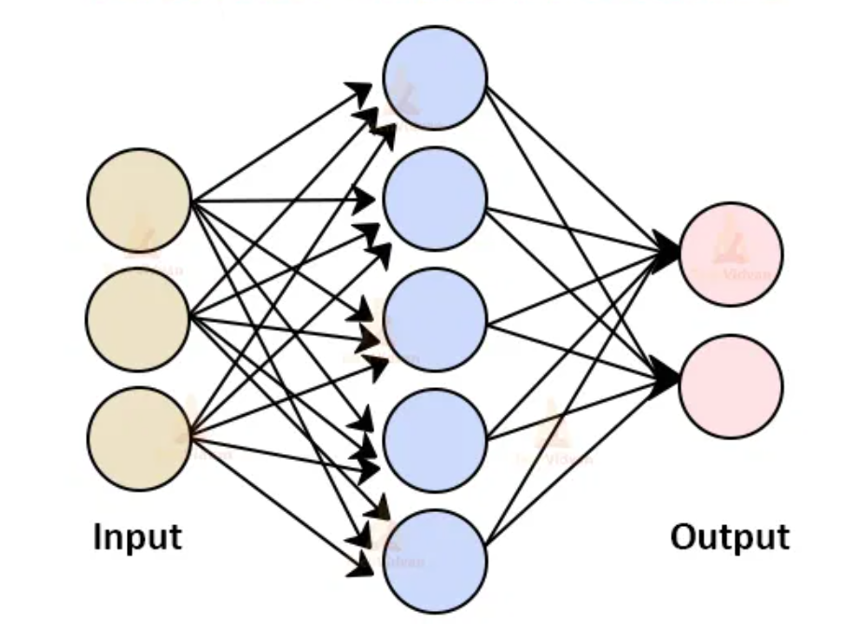
ANN (Artificial Neural Network)
In DL, a artificial neural network is a class of deep neural networks, can be used to model complex patterns and prediction problems.
neurally implemented mathematical model

Slide 30
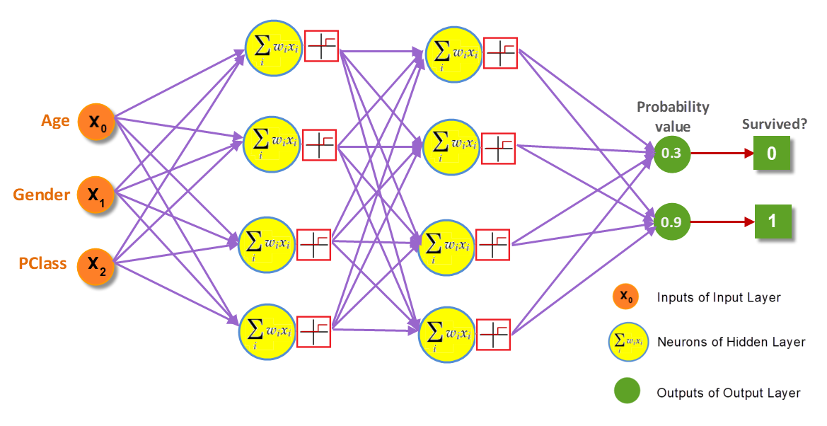
Multilayer Perceptron (MLP)
fully connected class of feedforward artificial neural network
Type of ANN with multiple layer

Slide 31
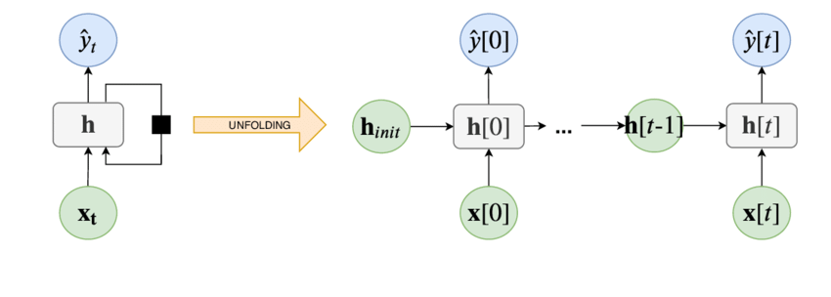
Simple RNN
recurrent NN where whose current output depends on the previous output
input value of the current state will be the output value of the previous state

Slide 32
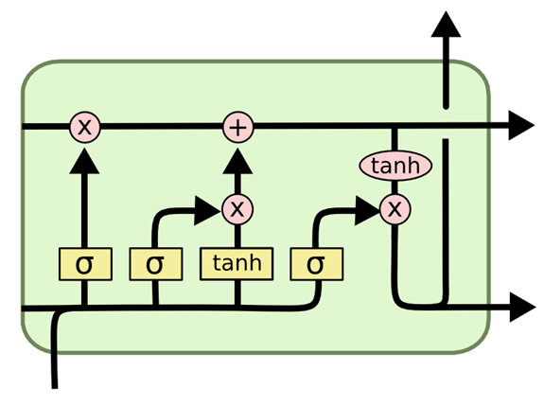
Gated Recurrent Network (GRU)
GRU may also be considered as a version of the LSTM
To address the vanishing gradient problem of a standard RNN, GRU utilizes the update and reset gates

Slide 33

Support Vector Machine (SVM)
Supervised learning algorithm works on the basis of hyper-plane
Chooses the extreme points/vectors that help in creating the hyperplane

Slide 34
Presentation Agenda
Introduction
Motivation
Problem Statement
Objective
Contribution
Existing Works
Proposed Methodology
Evaluations and results
Conclusion

Slide 35
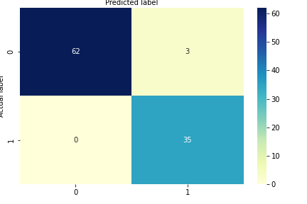

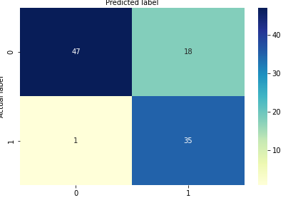
Evaluations and results
Confusion Matrix: this is a 2X2 matrix with values such as,
True Positive (TP), True Negative (TN),
False Positive (FP), False Negative (FN)
Ch² - ANN
Ch² - MLP
Ch² - GRU

Slide 36
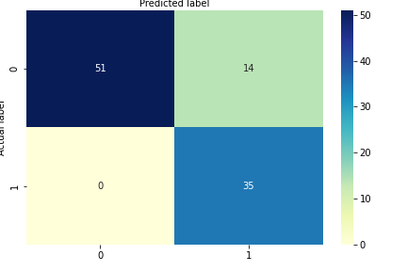
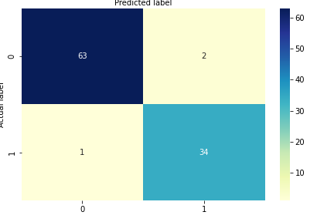

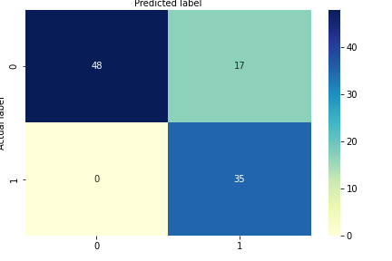

Evaluations and results

Slide 37

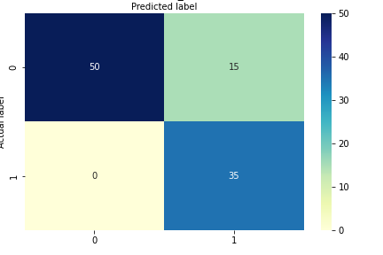
Evaluations and results
Ch² - RNN
Anova-F - MLP
Anova-F - ANN
Anova-F - GRU
Anova-F - RNN
SFFS - ANN

Slide 38

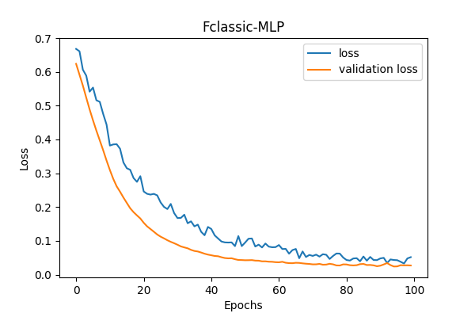
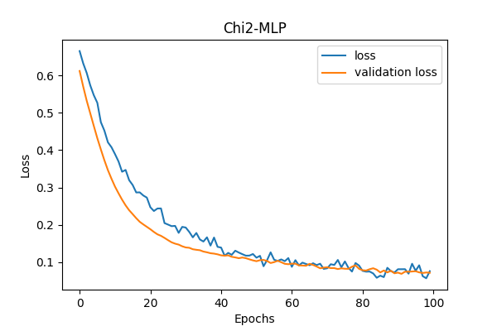
Evaluations and results
Choosen FST
Notes:
Once you find your sources, you will want to evaluate your sources using the following questions:
Author:
Who is the author?
Why should I believe what he or she has to say on the topic?
Is the author seen as an expert on the topic? How do you know?
Current:
How current is the information in the source?
When was the source published?
Is the information out-of-date?
Accuracy:
Is the content accurate?
Is the information presented objectively? Do they share the pros and cons?

Slide 39
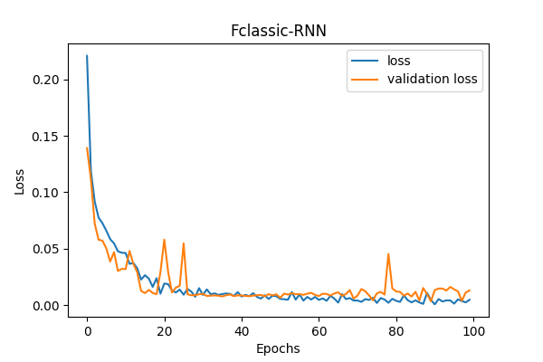
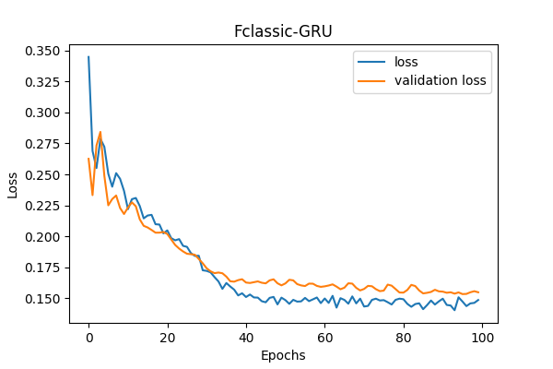
Evaluations and results
Notes:
Once you find your sources, you will want to evaluate your sources using the following questions:
Author:
Who is the author?
Why should I believe what he or she has to say on the topic?
Is the author seen as an expert on the topic? How do you know?
Current:
How current is the information in the source?
When was the source published?
Is the information out-of-date?
Accuracy:
Is the content accurate?
Is the information presented objectively? Do they share the pros and cons?

Slide 40
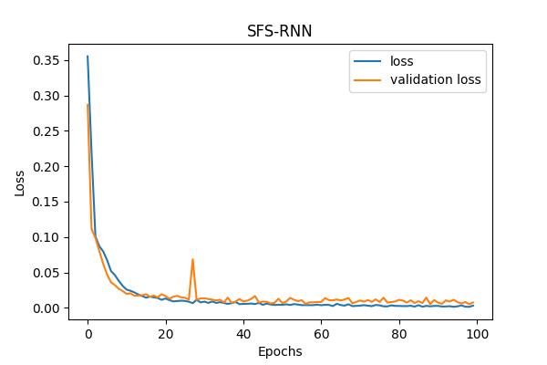
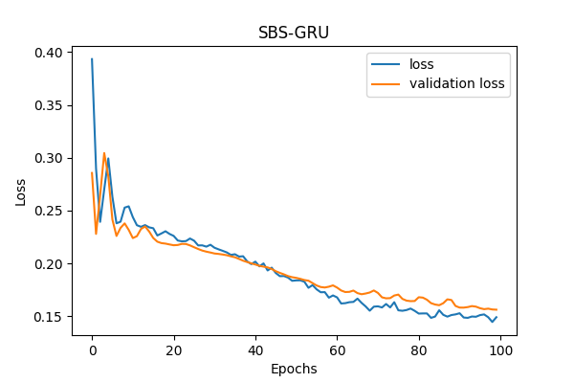
Evaluations and results
Notes:
Once you find your sources, you will want to evaluate your sources using the following questions:
Author:
Who is the author?
Why should I believe what he or she has to say on the topic?
Is the author seen as an expert on the topic? How do you know?
Current:
How current is the information in the source?
When was the source published?
Is the information out-of-date?
Accuracy:
Is the content accurate?
Is the information presented objectively? Do they share the pros and cons?

Slide 41
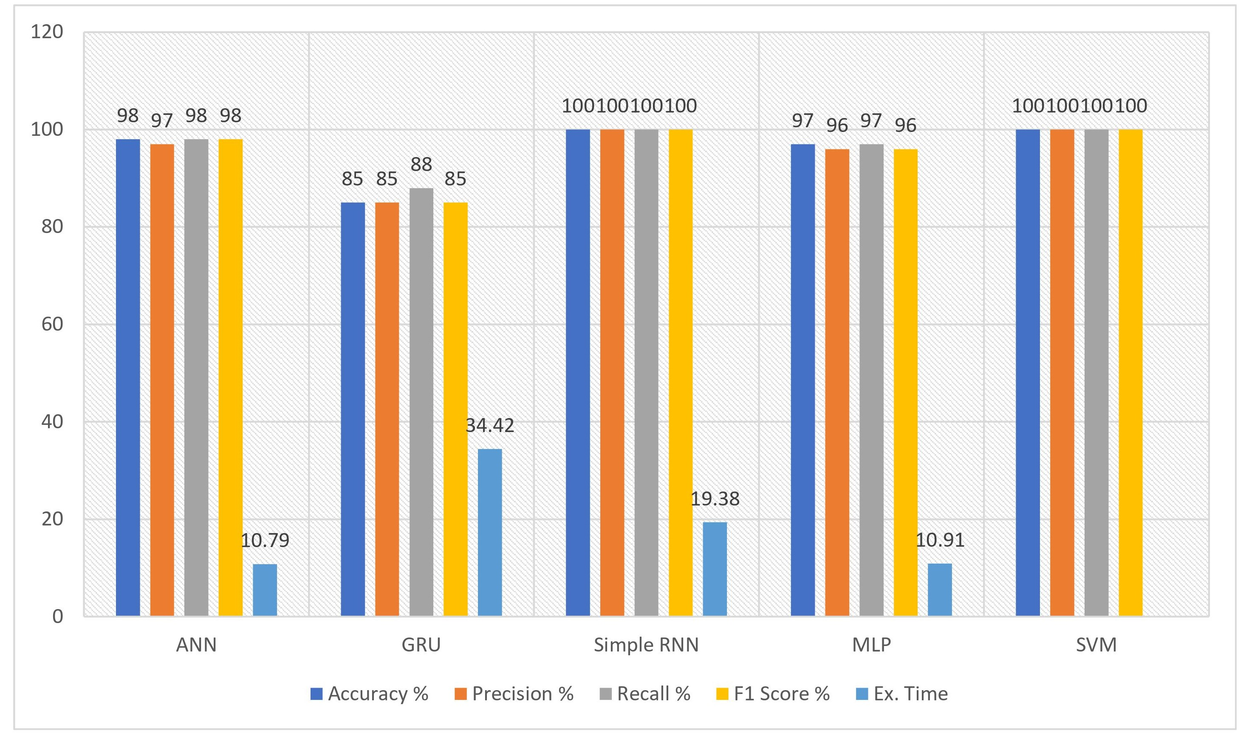
Evaluations and results
Performance are analysis based on the parameters:
Accuracy, Precision, Recall, F1 Score and Computational Time
 | Accuracy | Precision | Recall | F1 Score | Time
ANN | 98 | 97 | 98 | 98 | 10.79
GRU | 85 | 85 | 88 | 85 | 34.42
Simple RNN | 1 | 1 | 1 | 1 | 19.38
MLP | 97 | 96 | 97 | 96 | 10.91
SVM | 1 | 1 | 1 | 1
Comparative analysis of Without FST
Notes:
Once you find your sources, you will want to evaluate your sources using the following questions:
Author:
Who is the author?
Why should I believe what he or she has to say on the topic?
Is the author seen as an expert on the topic? How do you know?
Current:
How current is the information in the source?
When was the source published?
Is the information out-of-date?
Accuracy:
Is the content accurate?
Is the information presented objectively? Do they share the pros and cons?

Slide 42
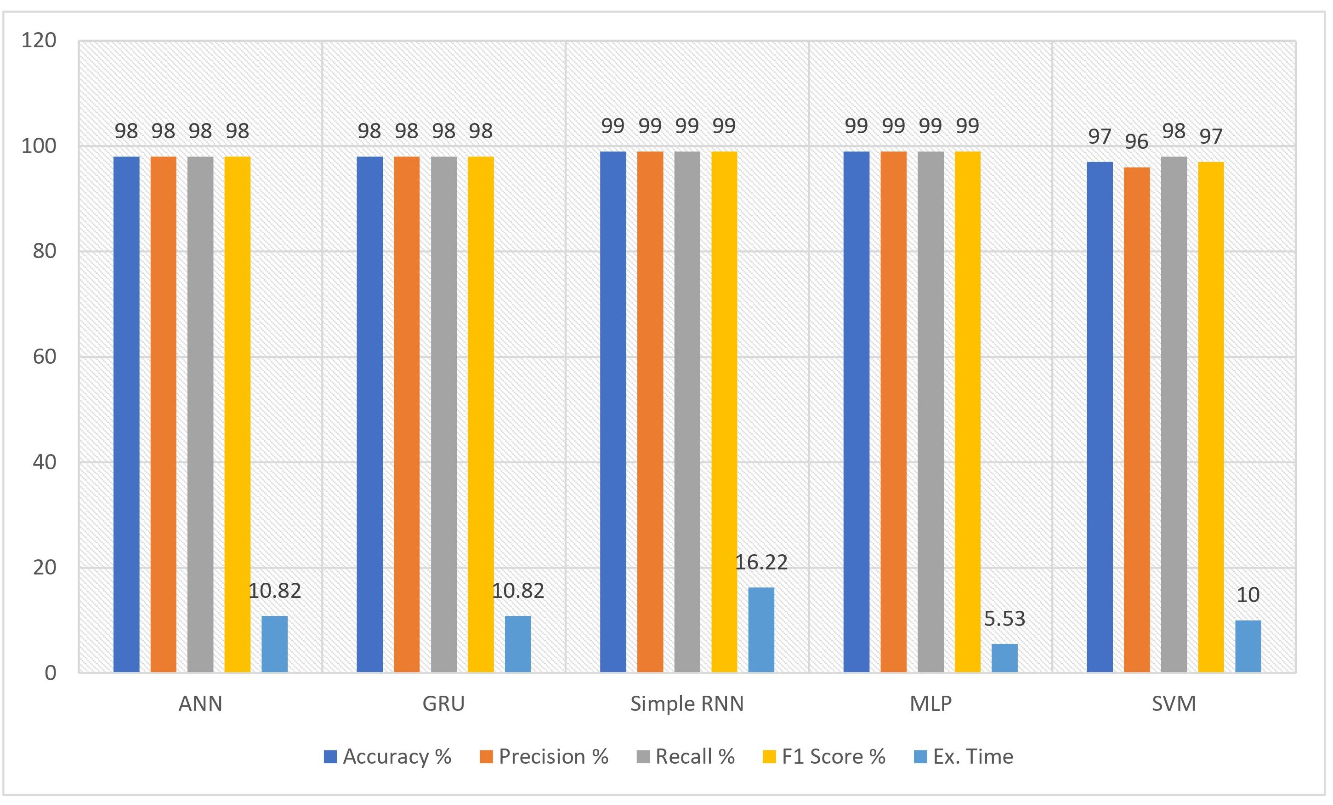
Evaluations and results
 | Accuracy | Precision | Recall | F1 Score | Time
ANN | 99 | 99 | 99 | 99 | 7.03
GRU | 98 | 98 | 98 | 98 | 10.82
Simple RNN | 99 | 99 | 99 | 99 | 16.22
MLP | 99 | 99 | 99 | 99 | 5.53
SVM | 97 | 96 | 98 | 97 | 10.0
Comparative analysis of Anova-F FST
Notes:
Once you find your sources, you will want to evaluate your sources using the following questions:
Author:
Who is the author?
Why should I believe what he or she has to say on the topic?
Is the author seen as an expert on the topic? How do you know?
Current:
How current is the information in the source?
When was the source published?
Is the information out-of-date?
Accuracy:
Is the content accurate?
Is the information presented objectively? Do they share the pros and cons?

Slide 43
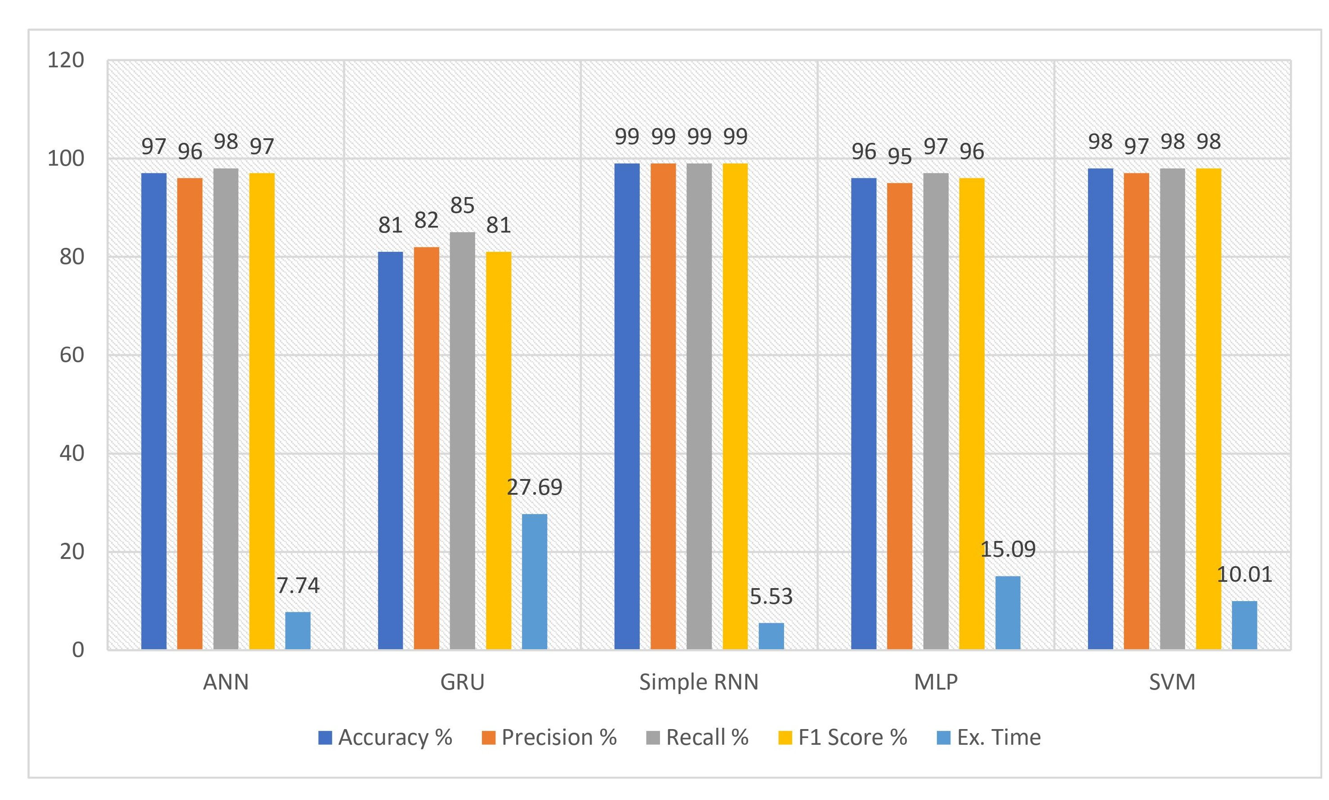
Evaluations and results
 | Accuracy | Precision | Recall | F1 Score | Time
ANN | 97 | 96 | 98 | 97 | 7.74
GRU | 0.81 | 0.82 | 0.85 | 0.81 | 27.69
Simple RNN | 0.99 | 0.99 | 0.99 | 0.99 | 5.53
MLP | 0.96 | 0.95 | 0.97 | 0.96 | 15.09
SVM | 0.98 | 0.97 | 0.98 | 0.98 | 10.0
Comparative analysis of Chi Squared FST
Notes:
Once you find your sources, you will want to evaluate your sources using the following questions:
Author:
Who is the author?
Why should I believe what he or she has to say on the topic?
Is the author seen as an expert on the topic? How do you know?
Current:
How current is the information in the source?
When was the source published?
Is the information out-of-date?
Accuracy:
Is the content accurate?
Is the information presented objectively? Do they share the pros and cons?

Slide 44
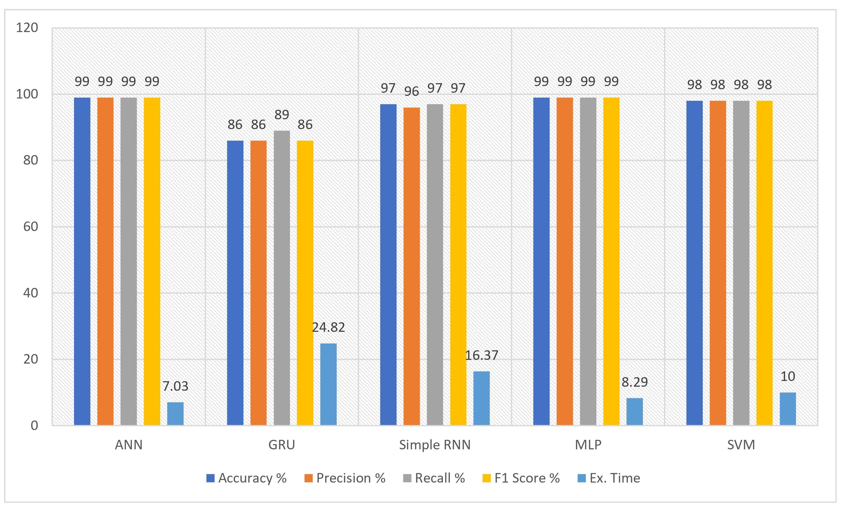
Evaluations and results
 | Accuracy | Precision | Recall | F1 Score | Time
ANN | 99 | 99 | 99 | 99 | 7.03
GRU | 86 | 86 | 89 | 86 | 24.82
Simple RNN | 97 | 96 | 97 | 97 | 16.37
MLP | 99 | 99 | 99 | 99 | 8.29
SVM | 98 | 98 | 98 | 98 | 10.0
Comparative analysis of SFFS FST
Notes:
Once you find your sources, you will want to evaluate your sources using the following questions:
Author:
Who is the author?
Why should I believe what he or she has to say on the topic?
Is the author seen as an expert on the topic? How do you know?
Current:
How current is the information in the source?
When was the source published?
Is the information out-of-date?
Accuracy:
Is the content accurate?
Is the information presented objectively? Do they share the pros and cons?

Slide 45
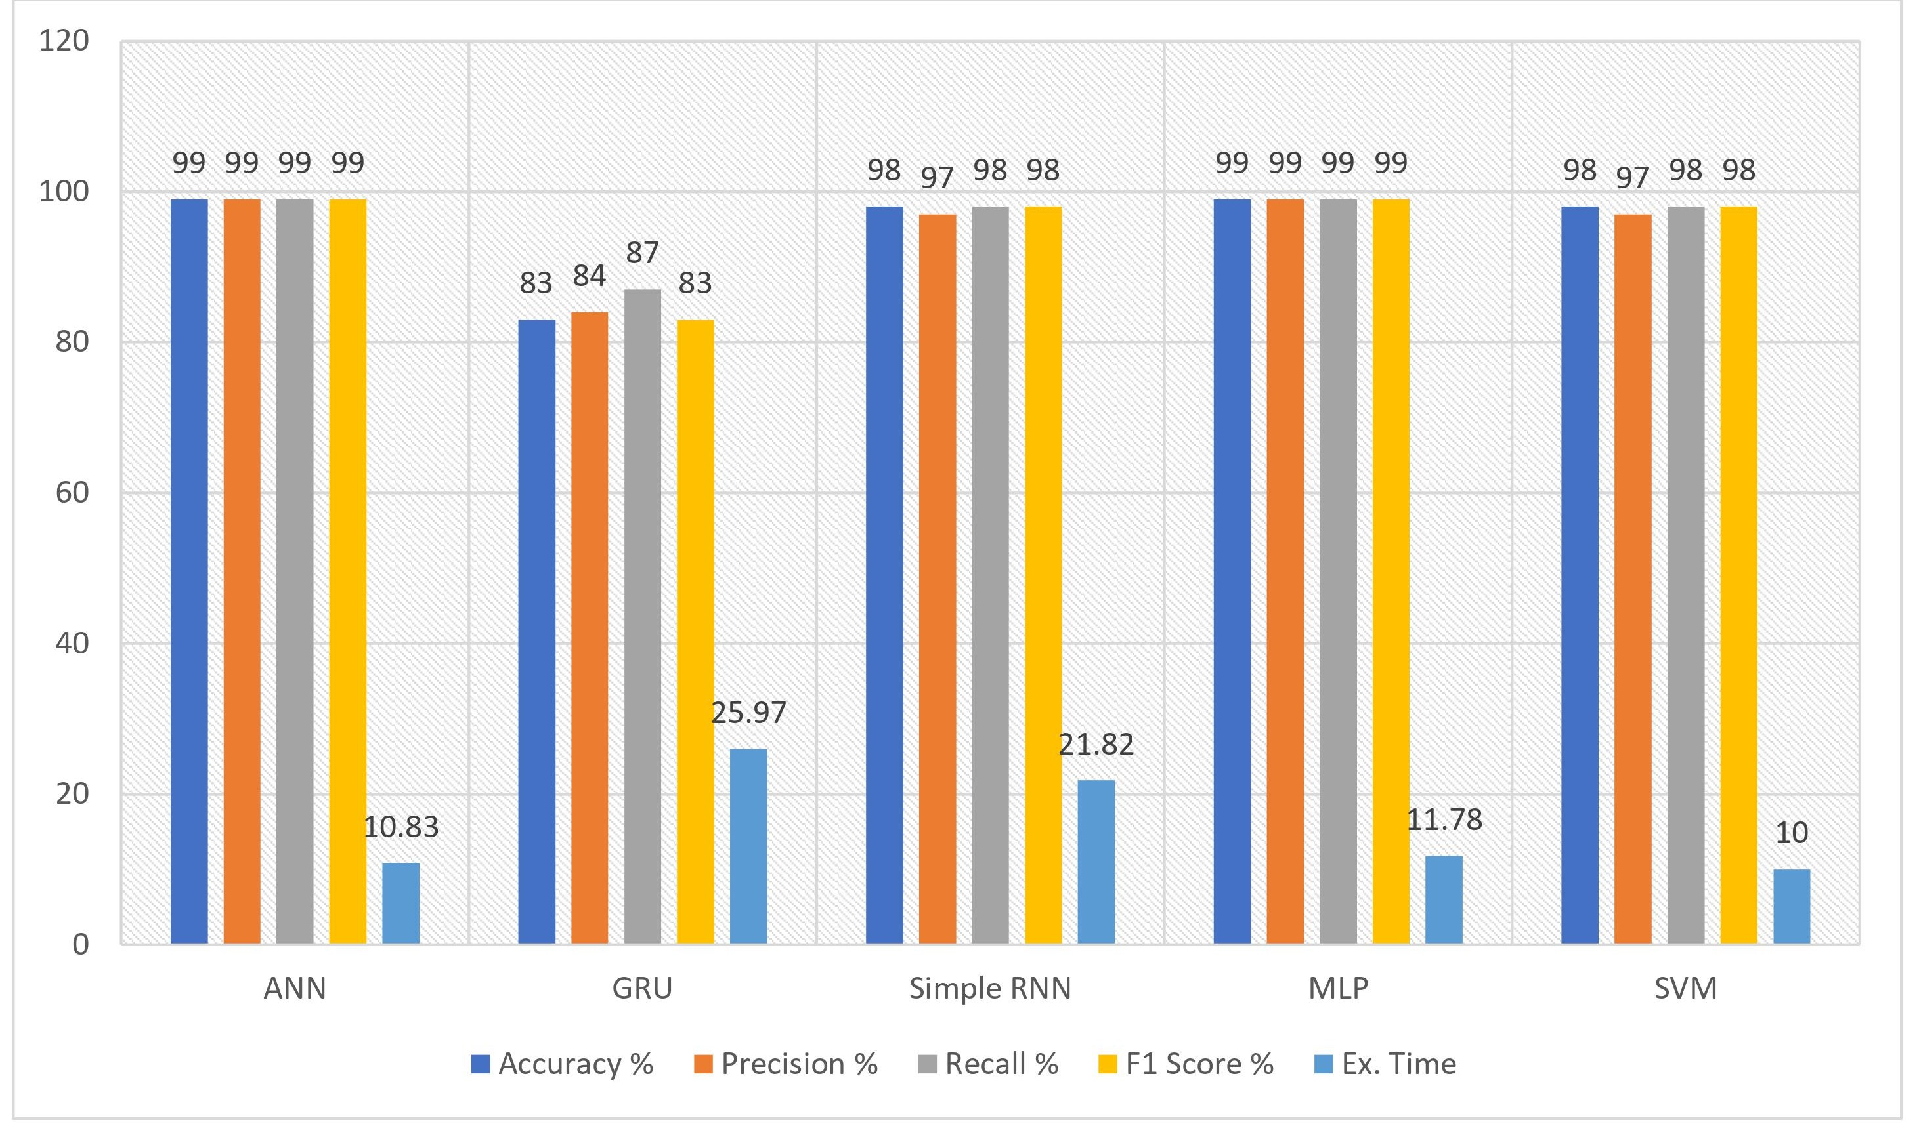
Evaluations and results
 | Accuracy | Precision | Recall | F1 Score | Time
ANN | 99 | 99 | 99 | 99 | 10.83
GRU | 83 | 84 | 87 | 83 | 25.97
Simple RNN | 98 | 97 | 98 | 98 | 21.82
MLP | 99 | 99 | 99 | 99 | 11.78
SVM | 98 | 97 | 98 | 98 | 10.0
Comparative analysis of SBFS FST
Notes:
Once you find your sources, you will want to evaluate your sources using the following questions:
Author:
Who is the author?
Why should I believe what he or she has to say on the topic?
Is the author seen as an expert on the topic? How do you know?
Current:
How current is the information in the source?
When was the source published?
Is the information out-of-date?
Accuracy:
Is the content accurate?
Is the information presented objectively? Do they share the pros and cons?

Slide 46
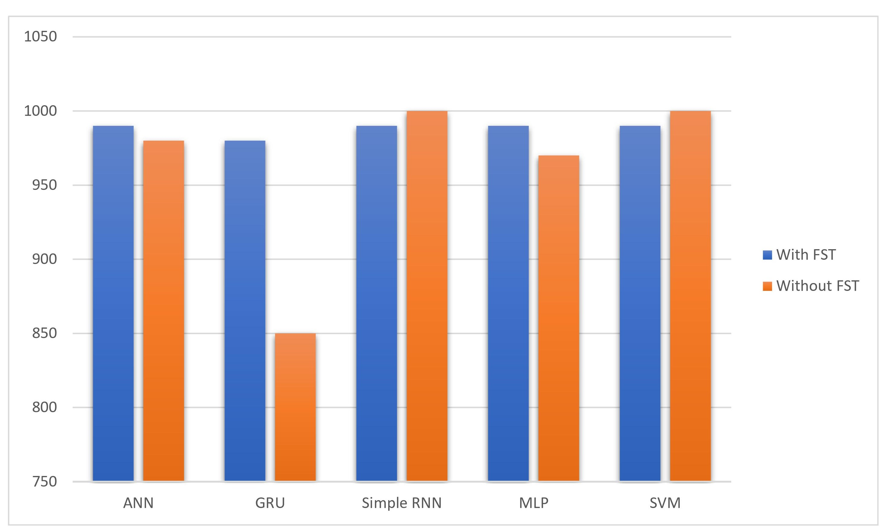
Performance Analysis
 | With FST | Without FST
ANN | 990 | 980
GRU | 980 | 850
Simple RNN | 990 | 1000
MLP | 990 | 970
SVM | 990 | 1000
Comparative analysis With and Without FST
Notes:
Once you find your sources, you will want to evaluate your sources using the following questions:
Author:
Who is the author?
Why should I believe what he or she has to say on the topic?
Is the author seen as an expert on the topic? How do you know?
Current:
How current is the information in the source?
When was the source published?
Is the information out-of-date?
Accuracy:
Is the content accurate?
Is the information presented objectively? Do they share the pros and cons?

Slide 47

Evaluations and results
Experimental Assessment:
Better performance in MLP based on ANOVA-F feature selection
Notes:
Once you find your sources, you will want to evaluate your sources using the following questions:
Author:
Who is the author?
Why should I believe what he or she has to say on the topic?
Is the author seen as an expert on the topic? How do you know?
Current:
How current is the information in the source?
When was the source published?
Is the information out-of-date?
Accuracy:
Is the content accurate?
Is the information presented objectively? Do they share the pros and cons?

Slide 48
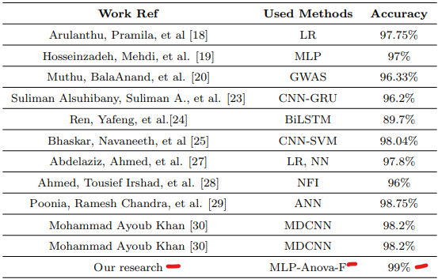
Evaluations and results
Comparative analysis of with Existing Works
Notes:
Once you find your sources, you will want to evaluate your sources using the following questions:
Author:
Who is the author?
Why should I believe what he or she has to say on the topic?
Is the author seen as an expert on the topic? How do you know?
Current:
How current is the information in the source?
When was the source published?
Is the information out-of-date?
Accuracy:
Is the content accurate?
Is the information presented objectively? Do they share the pros and cons?

Slide 49
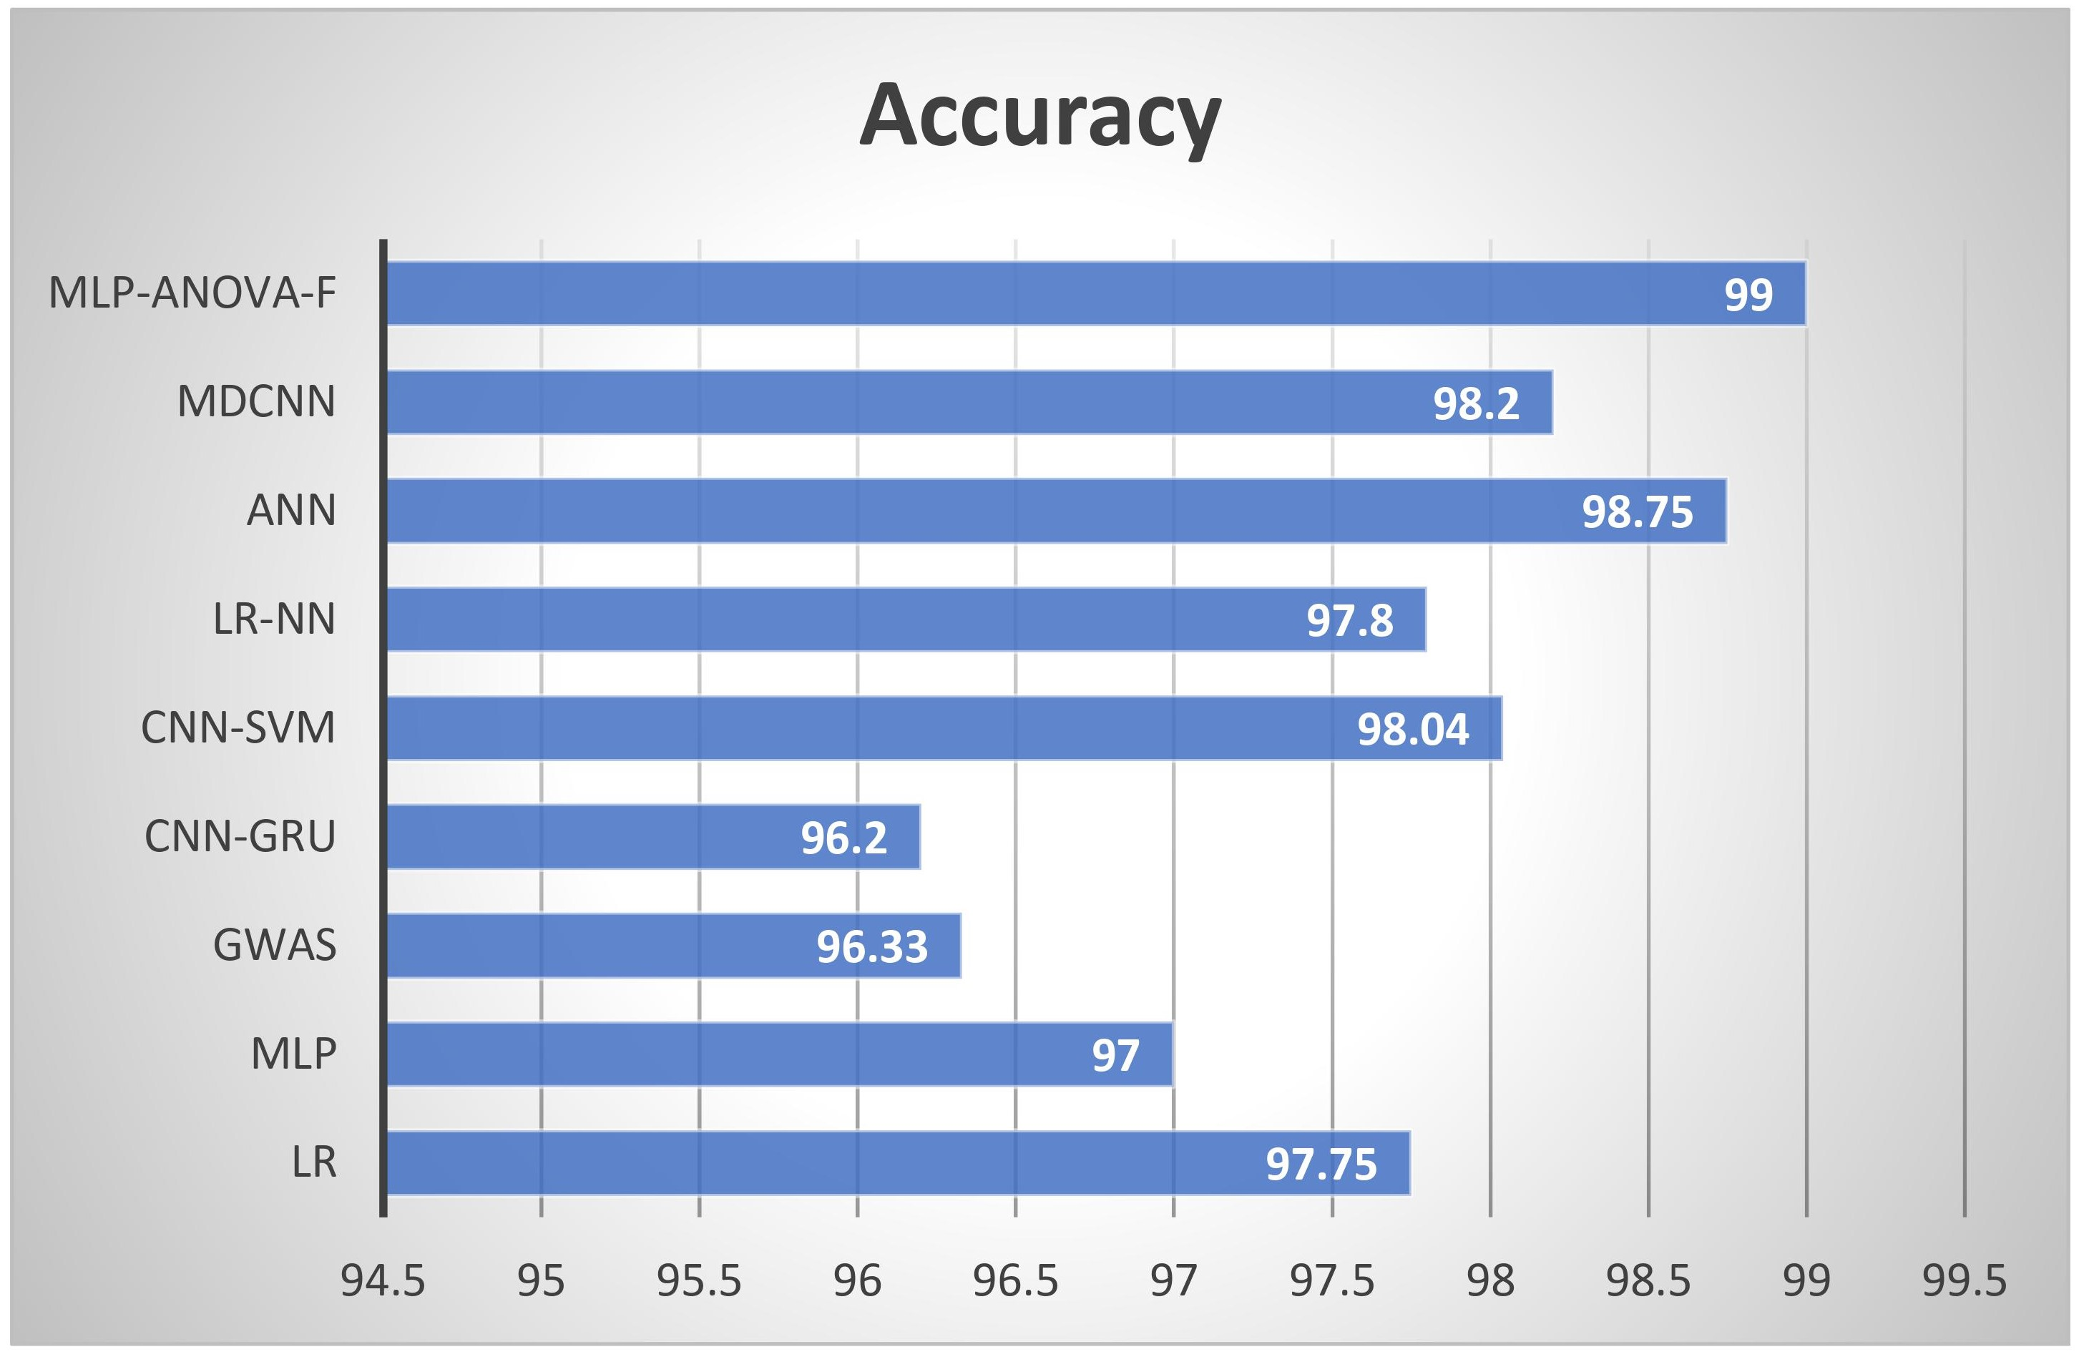
Evaluations and results
Comparative analysis of with Existing Works
Notes:
Once you find your sources, you will want to evaluate your sources using the following questions:
Author:
Who is the author?
Why should I believe what he or she has to say on the topic?
Is the author seen as an expert on the topic? How do you know?
Current:
How current is the information in the source?
When was the source published?
Is the information out-of-date?
Accuracy:
Is the content accurate?
Is the information presented objectively? Do they share the pros and cons?

Slide 50
Presentation Agenda
Introduction
Motivation
Problem Statement
Objective
Contribution
Existing Works
Proposed Methodology
Evaluations and results
Conclusion

Slide 51

Conclusion
With comparing four other classifiers, MLP provides higher 99% accuracy.
Using other FSTs although another model provides 99% accuracy, nevertheless, MLP is higher with respect to computational time (5.53 sec).
Limitations
IoT sensor is not implement practically
Less amount of sample in dataset
Notes:
After consulting a variety of sources, you will need to narrow your topic. For example, the topic of internet safety is huge, but you could narrow that topic to include internet safety in regards to social media apps that teenagers are using heavily. A topic like that is more specific and will be relevant to your peers. Some questions to think about to help you narrow your topic:
What topics of the research interest me the most?
What topics of the research will interest my audience the most?
What topics will the audience find more engaging? Shocking? Inspiring?

Slide 52
Conclusion
Future Directions
Use recent IoT data generate a big dataset
To solve the privacy issues of sharing data from the clinic
We will develop a model with decentralized data we
Notes:
After consulting a variety of sources, you will need to narrow your topic. For example, the topic of internet safety is huge, but you could narrow that topic to include internet safety in regards to social media apps that teenagers are using heavily. A topic like that is more specific and will be relevant to your peers. Some questions to think about to help you narrow your topic:
What topics of the research interest me the most?
What topics of the research will interest my audience the most?
What topics will the audience find more engaging? Shocking? Inspiring?

Slide 53
Bibliography:
[1] K. Kalantar-Zadeh, T. H. Jafar, D. Nitsch, B. L. Neuen, and V. Perkovic, “Chronic kidney disease,” The lancet, vol. 398, no. 10302, pp. 786–802, 2021.
[2] A. C. Webster, E. V. Nagler, R. L. Morton, and P. Masson, “Chronic kidney disease,” The lancet, vol. 389, no. 10075, pp. 1238–1252, 2017.
[3] V. Ravarotto, F. Simioni, E. Pagnin, P. A. Davis, and L. A. Cal`o, “Oxidative stress–chronic kidney disease–cardiovascular disease: A vicious circle,” Life sciences, vol. 210, pp. 125–131, 2018.
[4] A. Dorgelo and T. A. Oostrom, “An integrated approach towards a public health perspective on chronic kidney disease,” Nature Reviews Nephrology, vol. 18, no. 3, pp. 131–132, 2022.
[5] S. Akter, A. Habib, M. A. Islam, M. S. Hossen, W. A. Fahim, P. R. Sarkar, and M. Ahmed, “Comprehensive performance assessment of deep learning models in early prediction and risk identification of chronic kidney disease,” IEEE Access, vol. 9, pp.
165 184–165 206, 2021.
[6] B. W. Teo, G. C. Chan, C. C. H. Leo, J. C. Tay, Y.-C. Chia, S. Siddique, Y. Turana, C.-H. Chen, H.-M. Cheng, S. Hoshide et al., “Hypertension and chronic kidney 50 BIBLIOGRAPHY 51 disease in asian populations,” The Journal of Clinical Hypertension, vol. 23, no. 3, pp. 475–480, 2021.
[7] A. Alkhaqani, “Psychological impact of chronic kidney disease and hemodialysis: Narrative review,” Psychosom Med Res, vol. 4, no. 2, p. 3, 2022.
[8] J. Portol´es, L. Mart´ın, J. J. Broseta, and A. Cases, “Anemia in chronic kidney disease: From pathophysiology and current treatments, to future agents,” Frontiers in Medicine, vol. 8, p. 642296, 2021.
[9] M. Murton, D. Goff-Leggett, A. Bobrowska, J. J. Garcia Sanchez, G. James, E. Wittbrodt, S. Nolan, E. S¨orstadius, R. Pecoits-Filho, and K. Tuttle, “Burden of chronic kidney disease by kdigo categories of glomerular filtration rate and albuminuria: a systematic review,” Advances in therapy, vol. 38, no. 1, pp. 180–200, 2021.
[10] A. E. Beaudin, J. K. Raneri, S. B. Ahmed, A. M. Hirsch Allen, A. Nocon, T. Gomes, S. Gakwaya, F. Series, J. Kimoff, R. P. Skomro et al., “Risk of chronic kidney disease in patients with obstructive sleep apnea,” Sleep, vol. 45, no. 2, p. zsab267, 2022.
[11] D. Malta, K. S. Petersen, C. Johnson, K. Trieu, S. Rae, K. Jefferson, J. A. Santos, M. M. Wong, T. S. Raj, J. Webster et al., “High sodium intake increases blood pressure and risk of kidney disease. from the science of salt: A regularly updated systematic review of salt and health outcomes (august 2016 to march 2017),” The Journal of Clinical Hypertension, vol. 20, no. 12, pp. 1654–1665, 2018.

Slide 54
Bibliography:
[12] B. Thomas, “The global burden of diabetic kidney disease: time trends and gender gaps,” Current diabetes reports, vol. 19, no. 4, pp. 1–7, 2019.
[13] K. J. Jager, C. Kovesdy, R. Langham, M. Rosenberg, V. Jha, and C. Zoccali, “A single number for advocacy and communication—worldwide more than 850 million individuals have kidney diseases,” pp. 1803–1805, 2019. BIBLIOGRAPHY 52
[14] S. D. Fraser and P. J. Roderick, “Kidney disease in the global burden of disease study 2017,” Nature Reviews Nephrology, vol. 15, no. 4, pp. 193–194, 2019.
[15] E. W. G. D. R. F. C. F. H. M. H. http://orcid. org/0000 0002-4935-9765 Hilbrands Luuk B Jager Kitty J Noordzij Marlies Vart Priya Gansevoort Ron T, “Chronic kidney disease is a key risk factor for severe covid-19: a call to action by the eraedta,” Nephrology Dialysis Transplantation, vol. 36, no. 1, pp. 87–94, 2021.
[16] J.-C. Lv and L.-X. Zhang, “Prevalence and disease burden of chronic kidney disease,” Renal Fibrosis: Mechanisms and Therapies, pp. 3–15, 2019.
[17] T. Liyanage, T. Ninomiya, V. Jha, B. Neal, H. M. Patrice, I. Okpechi, M.-h. Zhao, J. Lv, A. X. Garg, J. Knight et al., “Worldwide access to treatment for end-stage kidney disease: systematic review,” The Lancet, vol. 385, no. 9981, pp. 1975–1982, 2015.
[18] P. Arulanthu and E. Perumal, “An intelligent iot with cloud centric medical decision support system for chronic kidney disease prediction,” International Journal of Imaging Systems and Technology, vol. 30, no. 3, pp. 815–827, 2020.
[19] M. Hosseinzadeh, J. Koohpayehzadeh, A. O. Bali, P. Asghari, A. Souri, A. Mazaherinezhad, M. Bohlouli, and R. Rawassizadeh, “A diagnostic prediction model for chronic kidney disease in internet of things platform,” Multimedia Tools and Applications, vol. 80, no. 11, pp. 16 933–16 950, 2021.
[20] B. Muthu, C. Sivaparthipan, G. Manogaran, R. Sundarasekar, S. Kadry, A. Shanthini, and A. Dasel, “Iot based wearable sensor for diseases prediction and symptom analysis in healthcare sector,” Peer-to-peer networking and applications, vol. 13, no. 6, pp. 2123–2134, 2020..

Slide 55
Bibliography:
[21] G. Chen, C. Ding, Y. Li, X. Hu, X. Li, L. Ren, X. Ding, P. Tian, and W. Xue, “Prediction of chronic kidney disease using adaptive hybridized deep convolutional BIBLIOGRAPHY 53 neural network on the internet of medical things platform,” IEEE Access, vol. 8, pp. 100 497–100 508, 2020.
[22] S. Chaudhuri, A. Long, H. Zhang, C. Monaghan, J. W. Larkin, P. Kotanko, S. Kalaskar, J. P. Kooman, F. M. van der Sande, F. W. Maddux et al., “Artificial intelligence enabled applications in kidney disease,” in Seminars in Dialysis, vol. 34, no. 1. Wiley Online Library, 2021, pp. 5–16.
[23] S. A. Alsuhibany, S. Abdel-Khalek, A. Algarni, A. Fayomi, D. Gupta, V. Kumar, and R. F. Mansour, “Ensemble of deep learning based clinical decision support system for chronic kidney disease diagnosis in medical internet of things environment,” Computational Intelligence and Neuroscience, vol. 2021, 2021.
[24] Y. Ren, H. Fei, X. Liang, D. Ji, and M. Cheng, “A hybrid neural network model for predicting kidney disease in hypertension patients based on electronic health records,” BMC medical informatics and decision making, vol. 19, no. 2, pp. 131– 138, 2019.
[25] N. Bhaskar and S. Manikandan, “A deep-learning-based system for automated sensing of chronic kidney disease,” IEEE Sensors Letters, vol. 3, no. 10, pp. 1–4, 2019.
[26] A. Dogra, A. Kaur, and M. Shabaz, “Data collection for classification in iot and heart disease detection,” Annals of the Romanian Society for Cell Biology, pp. 2954–2964, 2021.
[27] A. Abdelaziz, A. S. Salama, A. Riad, and A. N. Mahmoud, “A machine learning model for predicting of chronic kidney disease based internet of things and cloud computing in smart cities,” in Security in smart cities: models, applications, and challenges. Springer, 2019, pp. 93–114.
[28] T. I. Ahmed, J. Bhola, M. Shabaz, J. Singla, M. Rakhra, S. More, I. A. Samori et al., “Fuzzy logic-based systems for the diagnosis of chronic kidney disease,” BioMed BIBLIOGRAPHY 54 Research International, vol. 2022, 2022.

Slide 56
Bibliography:
[29] R. C. Poonia, M. K. Gupta, I. Abunadi, A. A. Albraikan, F. N. Al-Wesabi, and M. A. Hamza, “Intelligent diagnostic prediction and classification models for detection of kidney disease,” in Healthcare, vol. 10, no. 2. MDPI, 2022, p. 371.
[30] M. A. Khan, “An iot framework for heart disease prediction based on mdcnn classifier,” IEEE Access, vol. 8, pp. 34 717–34 727, 2020.
[31] A. Nithya, A. Appathurai, N. Venkatadri, D. Ramji, and C. A. Palagan, “Kidney disease detection and segmentation using artificial neural network and multi-kernel k-means clustering for ultrasound images,” Measurement, vol. 149, p. 106952, 2020

Slide 57
